Slide 1
Before you begin
If a yellow security bar appears at the top of the screen in PowerPoint, click Enable Editing.
You need PowerPoint 2010 to view this presentation. If you don’t have PowerPoint 2010, download the PowerPoint Viewer (see the URL in the notes pane).
Notes:
Download the PowerPoint viewer at (http://www.microsoft.com/downloads/details.aspx?displaylang=en&FamilyID=cb9bf144-1076-4615-9951-294eeb832823)

Slide 2
Microsoft® Excel® 2010 Training
Make the switch to Excel 2010
Notes:
[Notes to trainer:
This presentation must be viewed in PowerPoint 2010. If you don’t have PowerPoint 2010, the videos included in the presentation will not play. If you don’t have PowerPoint 2010, download the PowerPoint Viewer to view these files (http://www.microsoft.com/downloads/details.aspx?displaylang=en&FamilyID=cb9bf144%2D1076%2D4615%2D9951%2D294eeb832823).
If the yellow security bar appears at the top of the screen in PowerPoint, or if a Codec Unavailable message appears in the video playback window, the presentation might have opened in Protected View. To enable video playback, in the yellow security bar at the top of the PowerPoint window, click Enable Editing.
If students haven’t spent much time working in any versions of Microsoft Excel, they can refer to the following articles on Office.com:
Quick Start: Create a workbook (http://office.microsoft.com/en-us/excel-help/quick-start-create-a-workbook-HA010372780.aspx)
Quick Start: Edit and enter data in a worksheet (http://office.microsoft.com/en-us/excel-help/quick-start-edit-and-enter-data-in-a-worksheet-HA010370096.aspx)
For detailed help in customizing this template, see the very last slide. Also, look for additional lesson text in the notes pane of some slides.]

Slide 3
Course contents
Overview: Switching to Excel 2010
Lesson: Includes eight instructional movies
Test
Quick Reference

Slide 4

Overview: Switching to Excel 2010
Do you already know how to use Microsoft Excel? Are you making the switch to Excel 2010 from Excel 2003 or earlier?
If so, you’ve come to the right place to get familiar with the new version and to see how to do everyday tasks.

Slide 5
Course goals
Manage files by working in Microsoft Office Backstage view.
Complete basic, everyday tasks, such as formatting data and adding rows and columns.
Find commands for more advanced tasks, such as creating charts and using functions.
Add buttons for your favorite commands to your own toolbar.
Work between Excel 2010 and earlier versions.

Slide 6
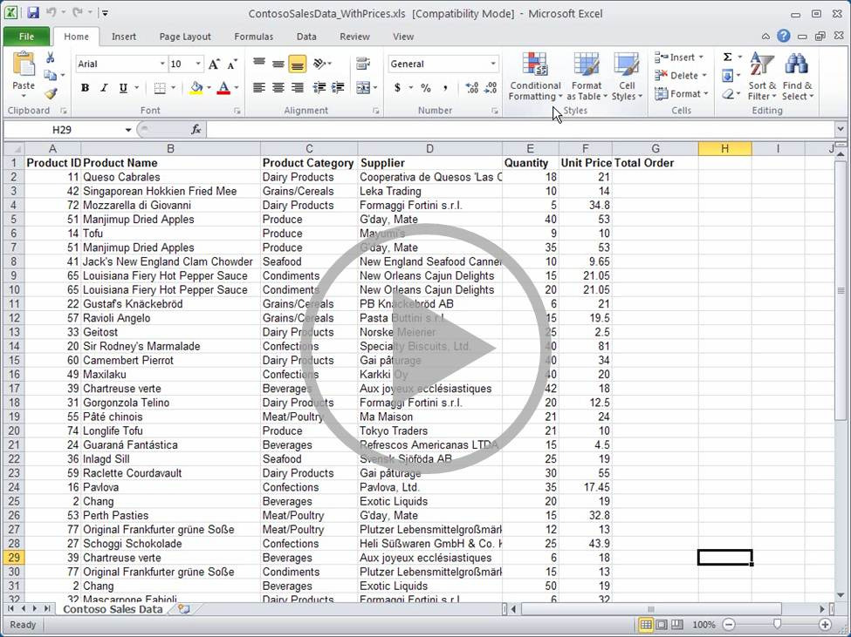
Get to work in Excel 2010
Point to the bottom of the video to see the video controls. Drag or point along the progress bar to move forward or go back.
Notes:
[Note to trainer: If you have trouble playing this video, for instance if a Codec Unavailable message appears in the video playback window, the presentation might have opened in Protected View. To enable video playback, in the yellow security bar at the top of the PowerPoint window, click Enable Editing. Note that even with Protected View turned on, video should play correctly in Slide Show view.]

Slide 7
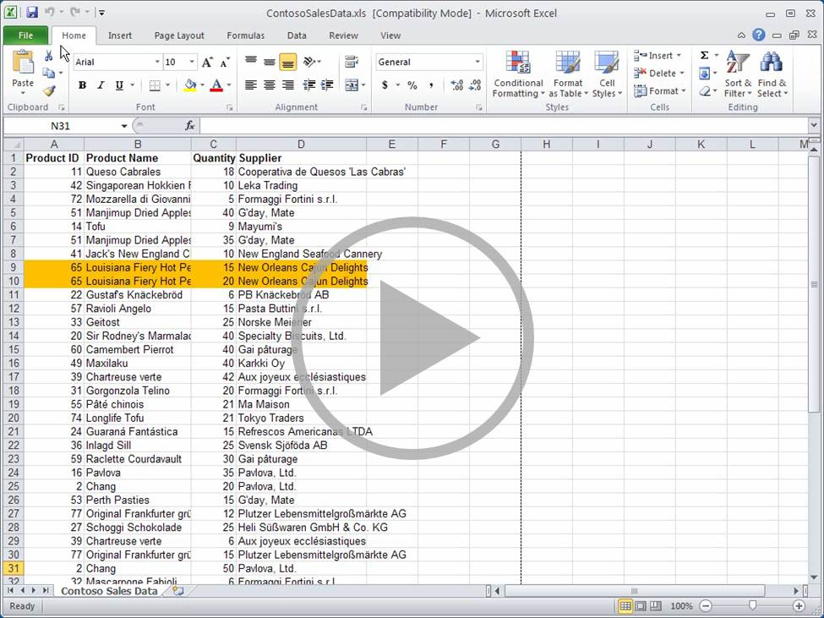
Work with files in Backstage view
Point to the bottom of the video to see the video controls. Drag or point along the progress bar to move forward or go back.
Notes:
[Note to trainer: If you have trouble playing this video, for instance if a Codec Unavailable message appears in the video playback window, the presentation might have opened in Protected View. To enable video playback, in the yellow security bar at the top of the PowerPoint window, click Enable Editing. Note that even with Protected View turned on, video should play correctly in Slide Show view.]

Slide 8
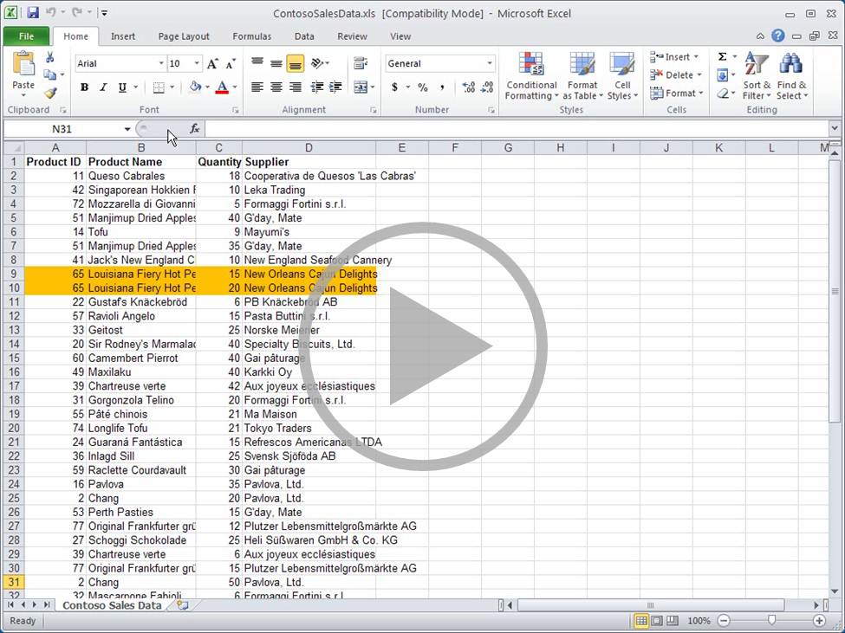
Do the basics on the Home tab
Point to the bottom of the video to see the video controls. Drag or point along the progress bar to move forward or go back.
Notes:
[Note to trainer: If you have trouble playing this video, for instance if a Codec Unavailable message appears in the video playback window, the presentation might have opened in Protected View. To enable video playback, in the yellow security bar at the top of the PowerPoint window, click Enable Editing. Note that even with Protected View turned on, video should play correctly in Slide Show view.]

Slide 9
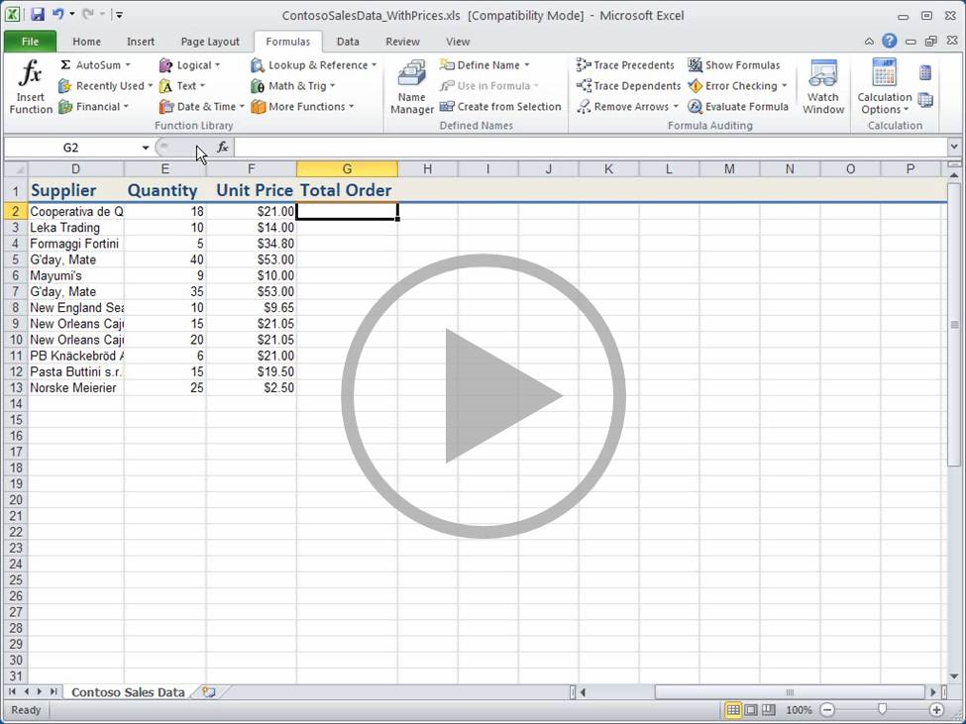
Math, anywhere
Point to the bottom of the video to see the video controls. Drag or point along the progress bar to move forward or go back.
Notes:
[Note to trainer: If you have trouble playing this video, for instance if a Codec Unavailable message appears in the video playback window, the presentation might have opened in Protected View. To enable video playback, in the yellow security bar at the top of the PowerPoint window, click Enable Editing. Note that even with Protected View turned on, video should play correctly in Slide Show view.]

Slide 10
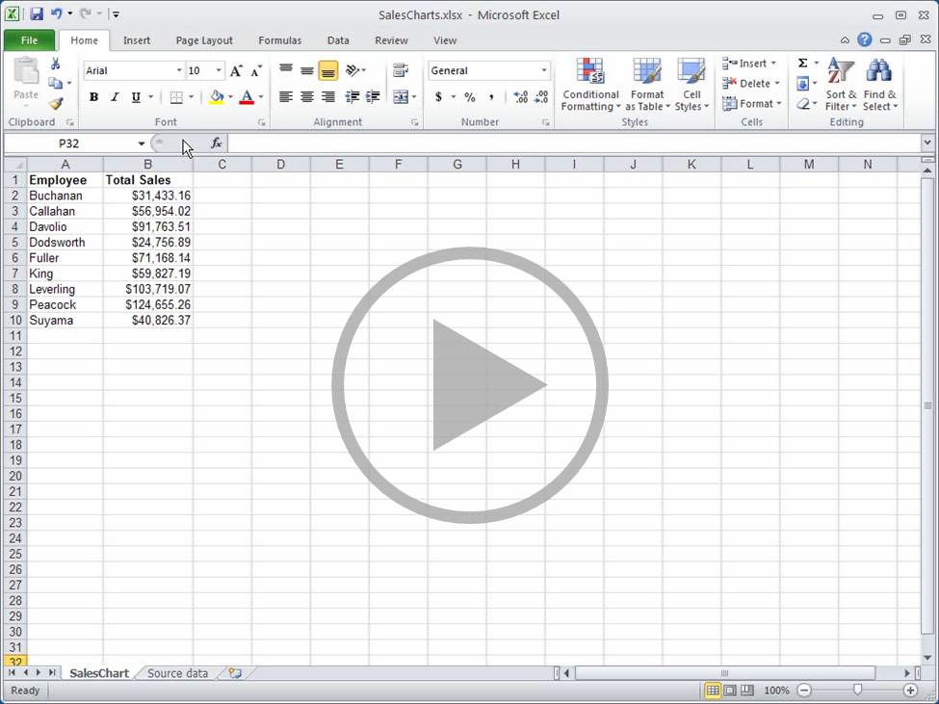
Commands when you need them
Point to the bottom of the video to see the video controls. Drag or point along the progress bar to move forward or go back.
Notes:
[Note to trainer: If you have trouble playing this video, for instance if a Codec Unavailable message appears in the video playback window, the presentation might have opened in Protected View. To enable video playback, in the yellow security bar at the top of the PowerPoint window, click Enable Editing. Note that even with Protected View turned on, video should play correctly in Slide Show view.]

Slide 11
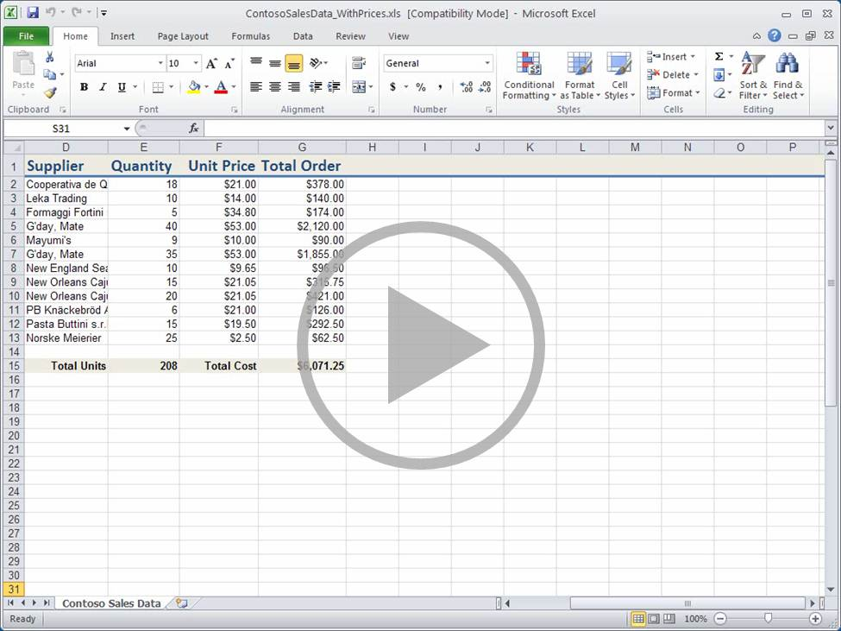
Use the keyboard
Point to the bottom of the video to see the video controls. Drag or point along the progress bar to move forward or go back.
Notes:
[Note to trainer: If you have trouble playing this video, for instance if a Codec Unavailable message appears in the video playback window, the presentation might have opened in Protected View. To enable video playback, in the yellow security bar at the top of the PowerPoint window, click Enable Editing. Note that even with Protected View turned on, video should play correctly in Slide Show view.]

Slide 12
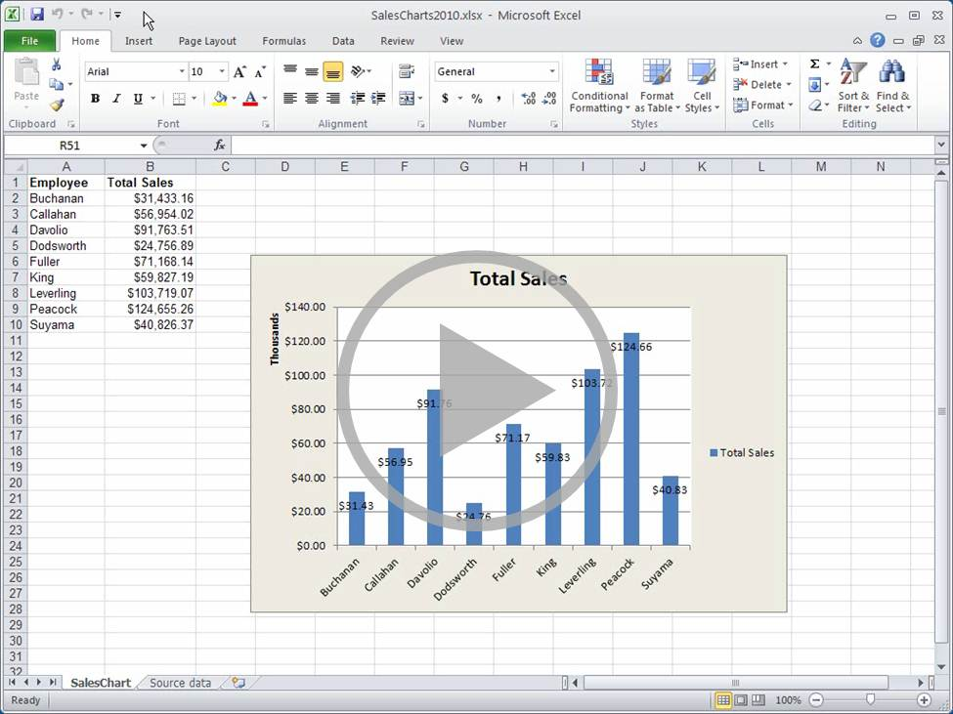
Keep your favorite buttons visible
Point to the bottom of the video to see the video controls. Drag or point along the progress bar to move forward or go back.
Notes:
[Note to trainer: If you have trouble playing this video, for instance if a Codec Unavailable message appears in the video playback window, the presentation might have opened in Protected View. To enable video playback, in the yellow security bar at the top of the PowerPoint window, click Enable Editing. Note that even with Protected View turned on, video should play correctly in Slide Show view.]

Slide 13
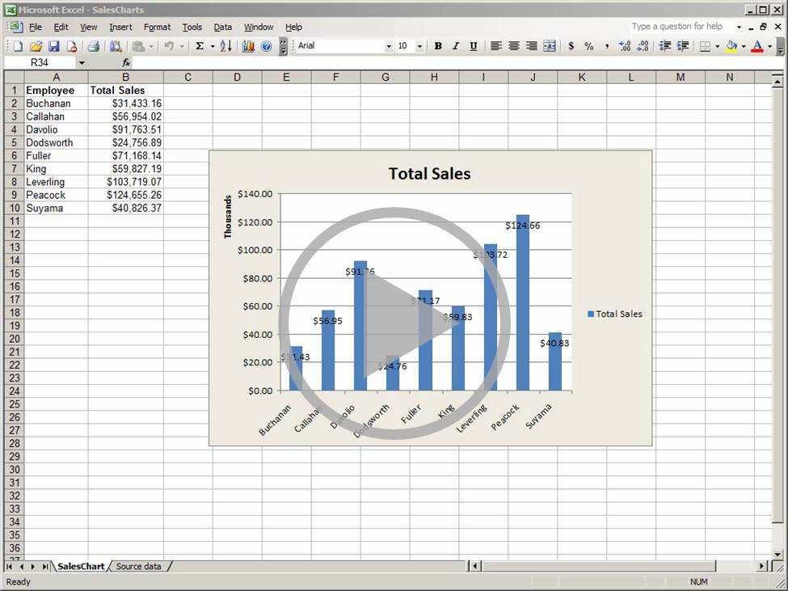
Work between new and old Excel versions
Point to the bottom of the video to see the video controls. Drag or point along the progress bar to move forward or go back.
Notes:
[Note to trainer: If you have trouble playing this video, for instance if a Codec Unavailable message appears in the video playback window, the presentation might have opened in Protected View. To enable video playback, in the yellow security bar at the top of the PowerPoint window, click Enable Editing. Note that even with Protected View turned on, video should play correctly in Slide Show view.]

Slide 14
Test question 1
To start Key Tips, you press which of the following keys? (Pick one answer.)
The CTRL key.
The SHIFT key.
The ALT key.
The TAB key.

Slide 15
Test question 1
To start Key Tips, you press which of the following keys?
Answer:
The ALT key.
Press ALT, and then the key or keys that start the command you want to use.

Slide 16
Test question 2
On the ribbon, which tabs have the commands for basic functions such as SUM and AVG? (Pick one answer.)
The Home and Functions tabs.
The Insert and Data tabs.
The Quick Access Toolbar and the Data tab.

Slide 17
Test question 2
On the ribbon, which tabs have the commands for basic functions such as SUM and AVG?
Answer:
The Home and Functions tabs.
You can also enter the functions in the Formula Bar regardless of the ribbon tab you’re using.

Slide 18
Test question 3
How to you get to Backstage view? (Pick one answer.)
Click the Home tab.
Click Backstage on the View tab.
Click the File tab.

Slide 19
Test question 3
How to you get to Backstage view?
Answer:
Click the File tab.
You can also start Backstage view by using Key Tips.

Slide 20
Test question 4
To view Excel 2010 files in Excel 2003, you must do which of the following? (Pick one answer.)
You can’t view 2010 files in 2003. You have to convert them all to the 2010 file format.
Download and install free converters.
You don’t need to do anything. Just open the files.

Slide 21
Test question 4
To view Excel 2010 files in Excel 2003, you must do which of the following?
Answer:
Download and install free converters.
Make sure your version of Excel is fully patched by installing and downloading free converters.

Slide 22
Test question 5
Which tab do you use to do math? (Pick one answer.)
The Formulas tab.
The Home tab.
You can use any tab.

Slide 23
Test question 5
Which tab do you use to do math?
Answer:
You can use any tab.
In Excel 2010, you can do math while you’re working in any tab.

Slide 24
Quick Reference Card
For a summary of the tasks covered in this course, view the Quick Reference Card.

Slide 25
Using this template
See the notes pane or view the full notes page (View tab, Notes Page) for detailed help on this template.
Notes:
Using This Template
This Microsoft PowerPoint® template has training content that helps familiarize you with Microsoft Excel® 2010. Its content is adapted from the Office.com Training course called “Make the switch to Excel 2010.”
PowerPoint version: The template must be viewed in PowerPoint 2010. If you don’t have PowerPoint 2010, the videos included in the presentation will not play. If you don’t have PowerPoint 2010, download the PowerPoint Viewer to view these files (http://www.microsoft.com/downloads/details.aspx?displaylang=en&FamilyID=cb9bf144%2D1076%2D4615%2D9951%2D294eeb832823). Video playback: If the yellow security bar appears at the top of the screen in PowerPoint, or if a Codec Unavailable message appears in the video playback window, the presentation might have opened in Protected View. To enable video playback, in the yellow security bar at the top of the PowerPoint window, click Enable Editing.
Slide layouts: Each slide has a custom layout. To apply the custom layout to a new slide, right-click the slide thumbnail, point to Layout, and click the layout from the Layout gallery. To alter the layouts, open master view and alter the specific master layout in that view. You can find the layout’s title by pointing to its thumbnail.
Animations: Custom animation effects are applied throughout the presentation. These include Float In (Up or Down option), Fade, and Zoom. To alter animation effects, click the Animations tab, and use the Add Animation gallery and Timing options. Effect Options gives you choices about the effect; click Animation Pane on the Animations tab to work with multiple animations.
Transitions: One transition, Doors, is used to emphasize sections of the slide show. It’s applied on the Course Contents slide, Lesson slide, and the first test slide.
Hyperlink to online course: The template contains a link to the online version of this training course that takes you to the Quick Reference Card that is published for this course.
Headers and footers: The template contains a footer that has the course title. To add footers such as the date or slide numbers, click the Insert tab, and click Header & Footer.

